Slide 1

Introducing
Isha Advertising Pvt. Ltd
Since 1991

Slide 2


30 YEARS OLD ADVERTISING & MARKETING AGENCY
EFFECTIVE IT BACKED BRANDING SOLUTIONS
360 DEGREE ADVERTISING SOLUTIONS
GOOD FINANCIAL TRACK
Smart people with a blend of Old and Young creates smart and innovative solutions-
At IAPL we are blessed to have this.
IAPL
2

Slide 3

OUR SERVICES
1
2
3
4
PRINT MEDIA
ELECTRONIC MEDIA
OUTDOOR MEDIA
DIGITAL MEDIA
5
6
7
8
PUBLIC RELATIONS
PRINT PRODUCTIONS
VIDEO STUDIO
EVENT & EXHIBITION
Delivering results-oriented brand marketing programs and public relations campaigns that
enhance our clients’ awareness, improve their sales and foster their growth.
IAPL
3

Slide 4

OUR CLIENTS
BHEL
Power Grid
Kribhco
Kendriya Vidyalaya
CCIC
APEDA
GSTN
NFDC
Rail Vikas Nigam Ltd.
ACASH
NHDC
HHEC
HEPC
NFL
AEPC & ATDC
UPSIDC
NEHHDC
STC
Many more…
Mahindra & Mahindra
Mahindra First Choice Wheels Ltd.
Mahindra Tech.
Tata Motors.
Honda Motors India
Glen Appliances
Nissan & Datsun
Jaguar & Land Rover
Many more…
Min. of Textiles
Min. of Chemical & Fertilizers
Min. of Earth Sciences
Min. of Panchayati Raj
Ministry of Development Of North Eastern Region
Ministry of Education
IAPL
4

Slide 5


Glimpse of
Our Work
IAPL
www.GoogleSlides.org
5

Slide 6
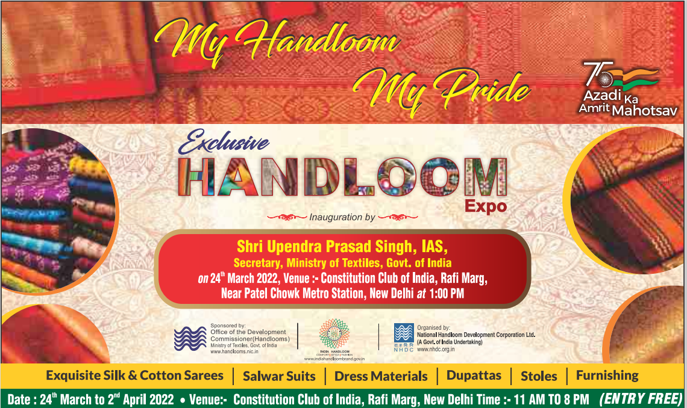
P
R
I
N
T
M
E
D
I
A

Slide 7
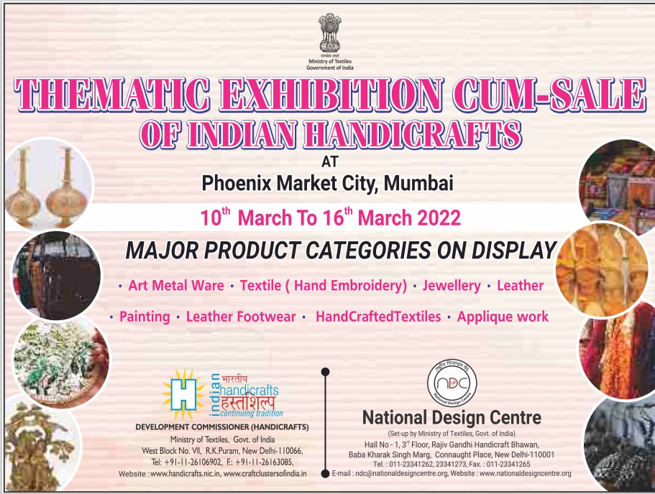

Slide 8
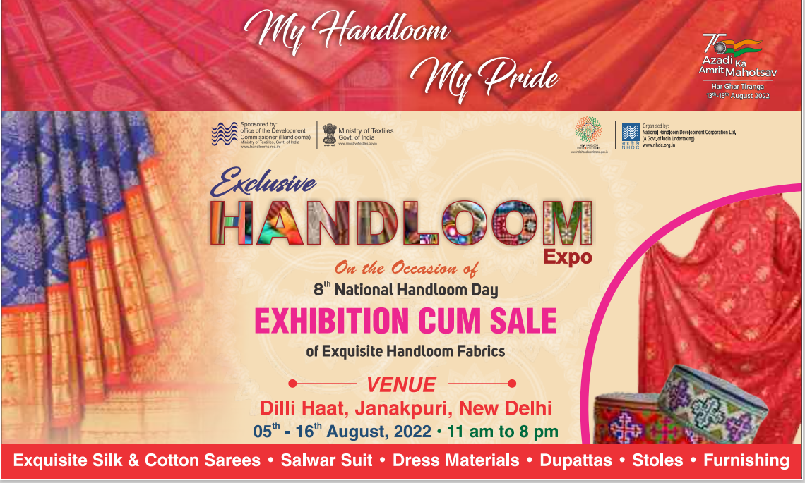

Slide 9
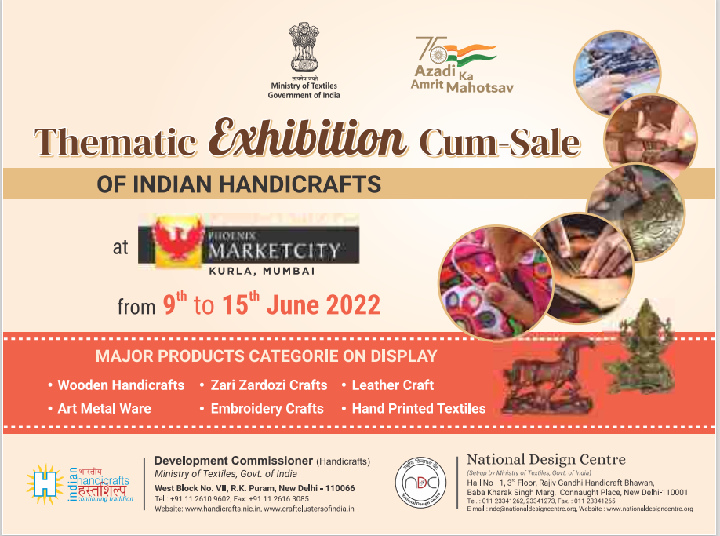

Slide 10


Slide 11


Slide 12



Slide 13

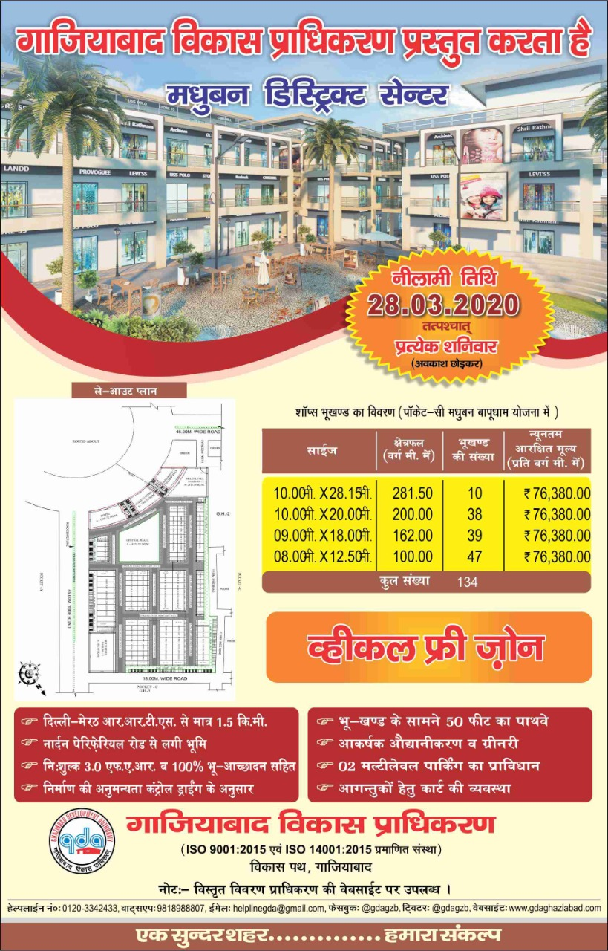

Slide 14


Slide 15
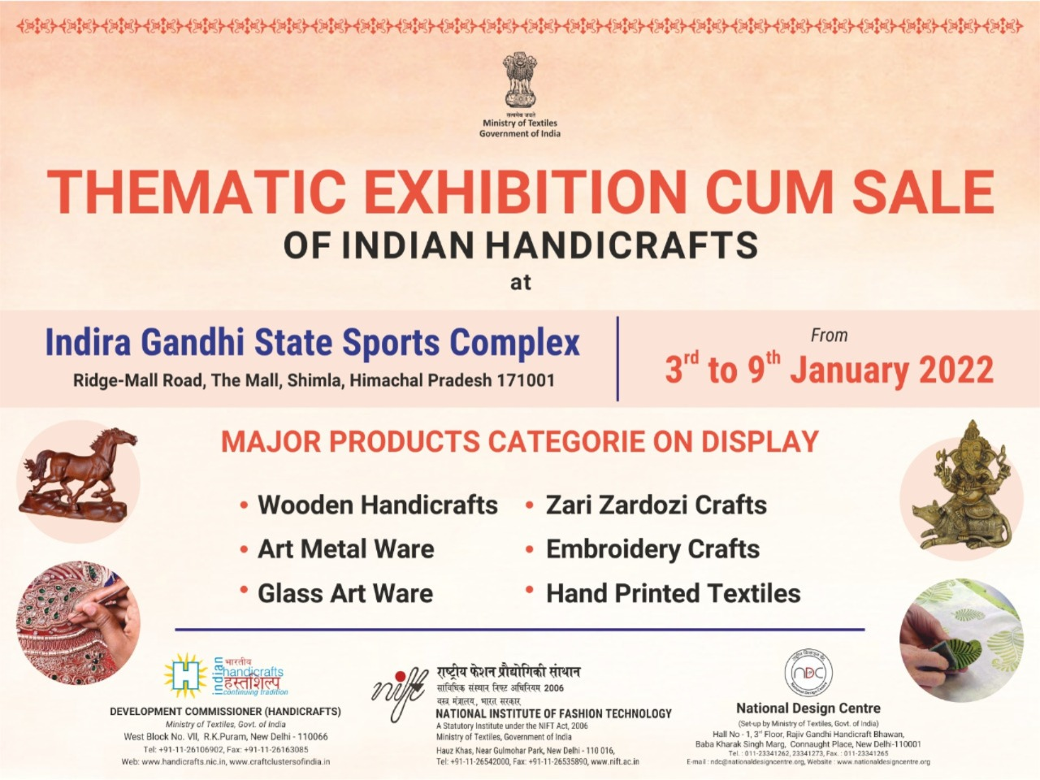
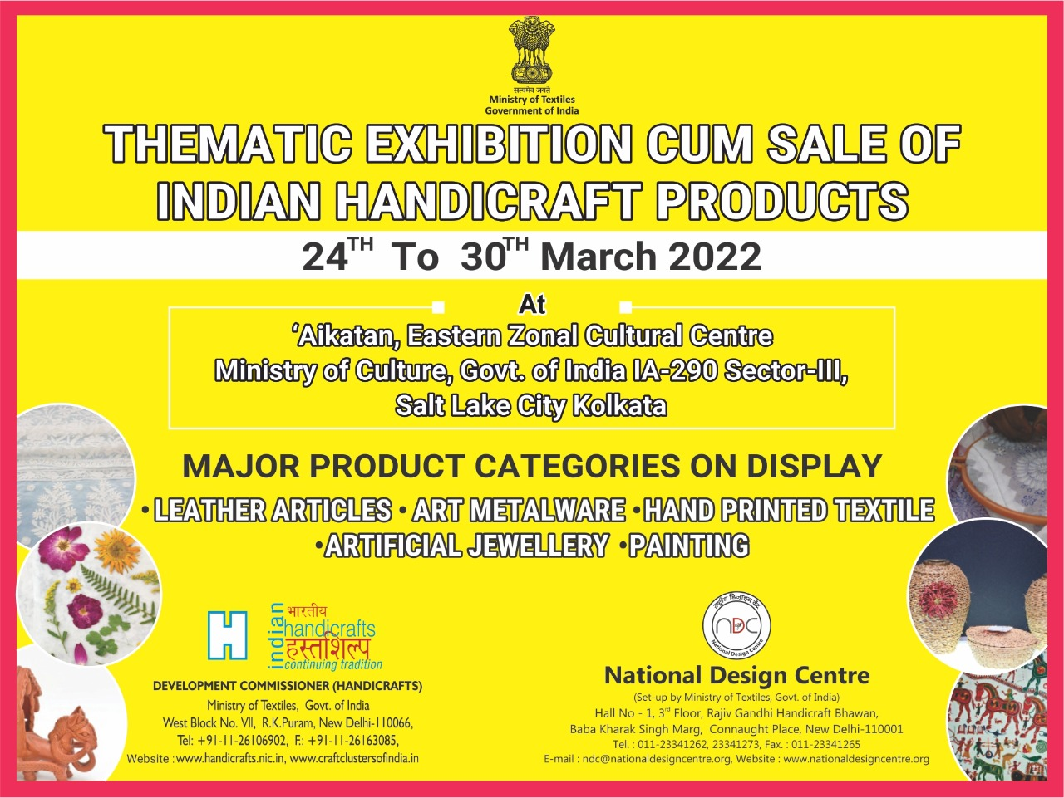

Slide 16


Slide 17



Slide 18
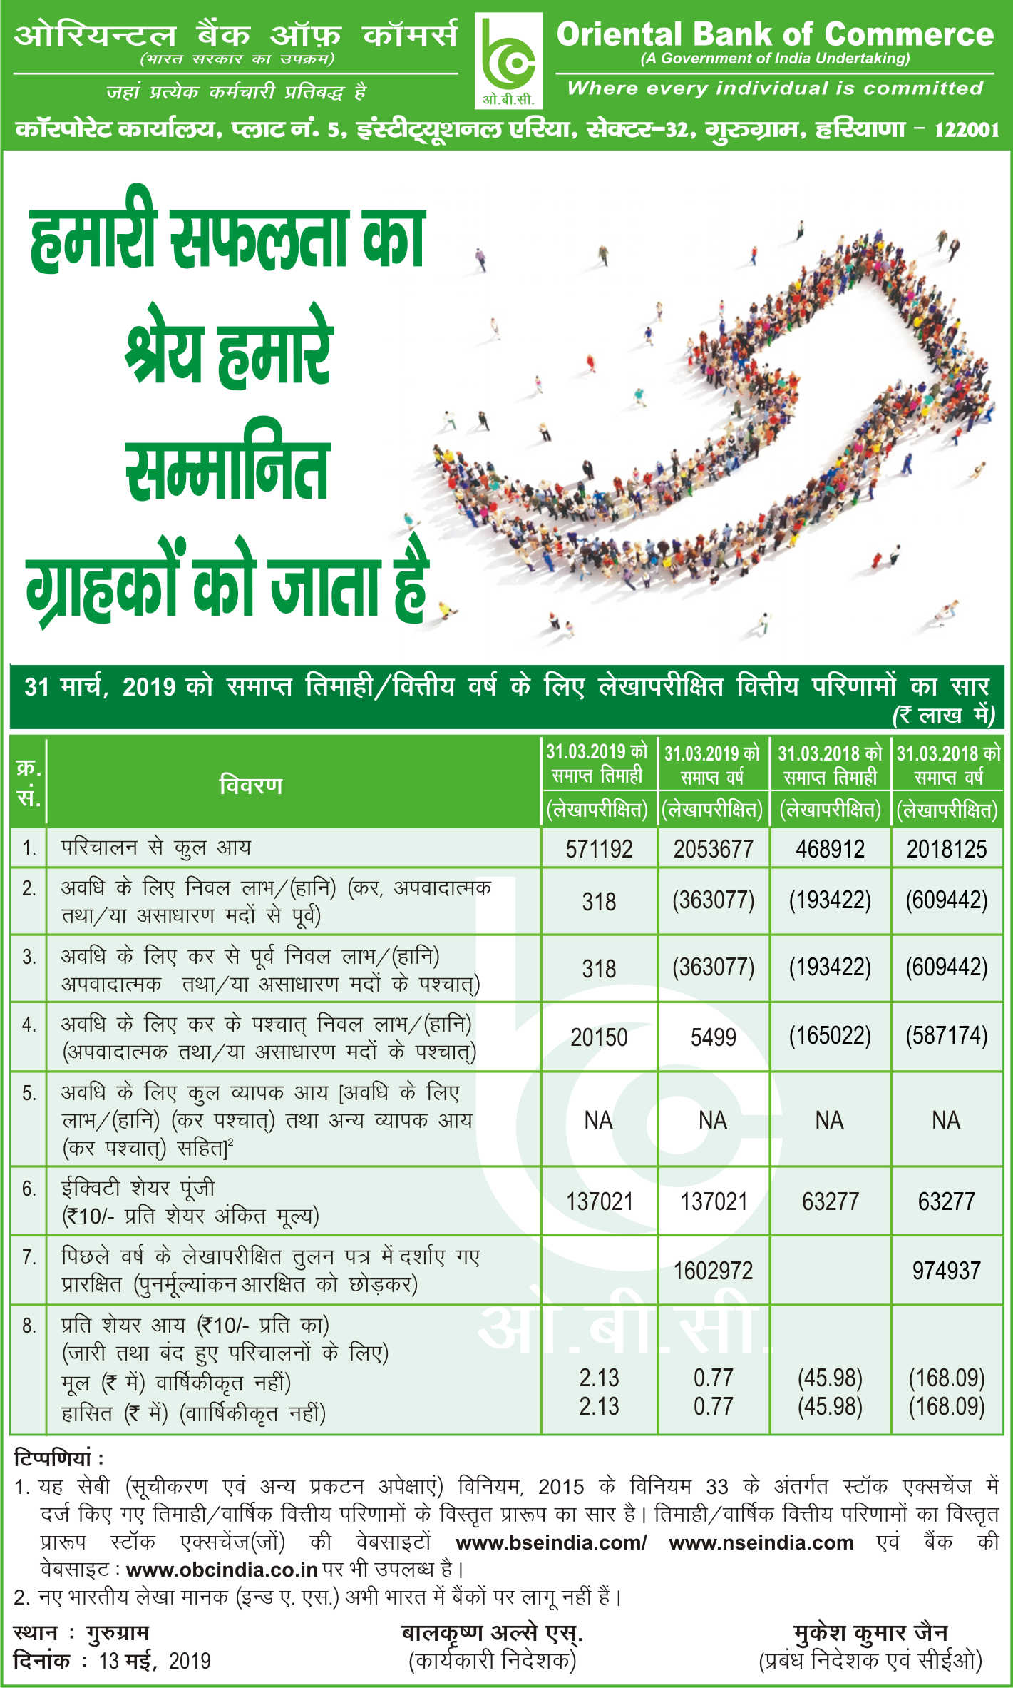



Slide 19







Slide 20

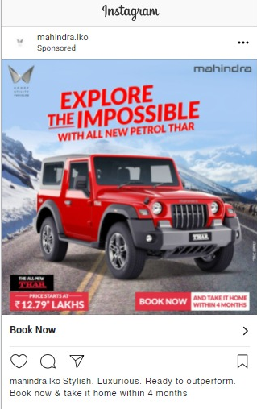

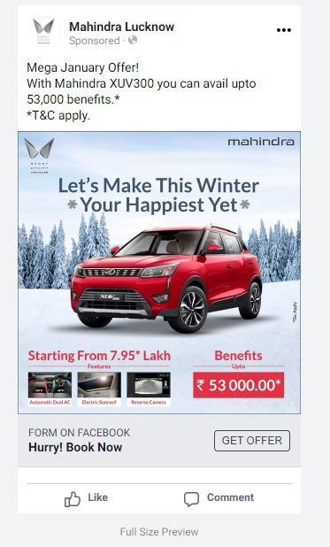
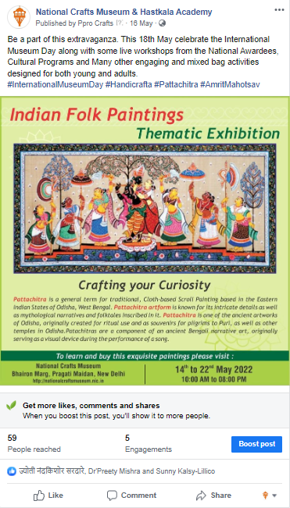

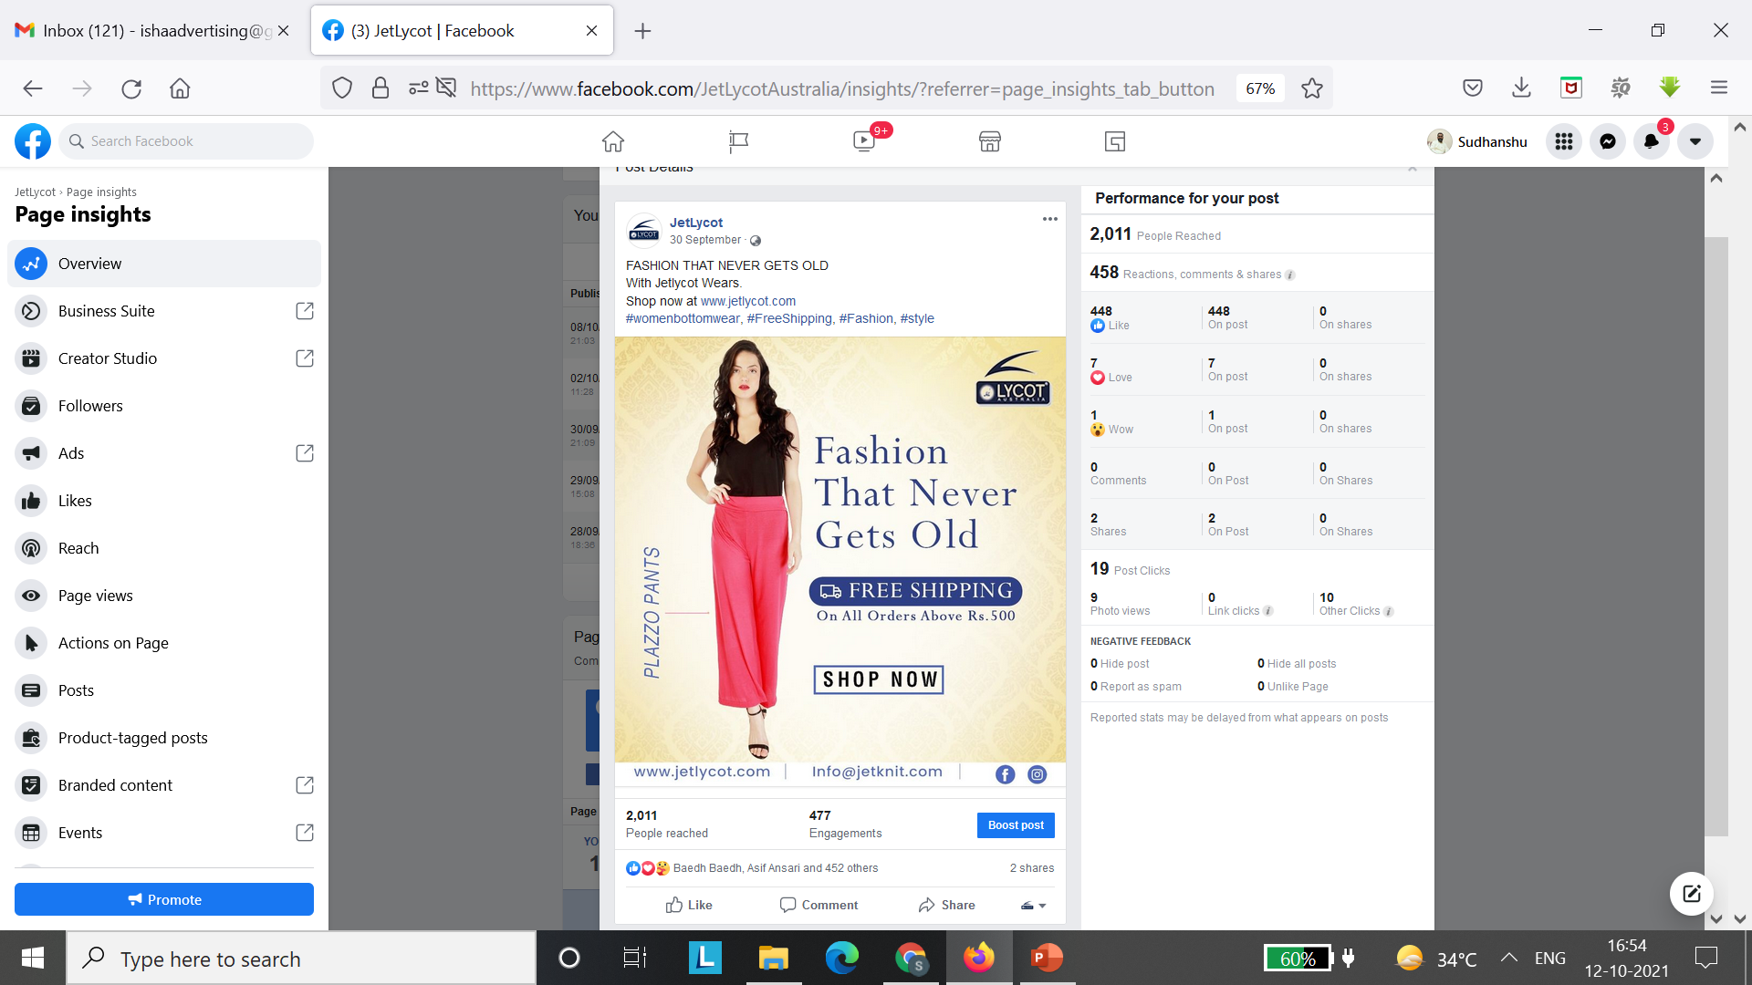
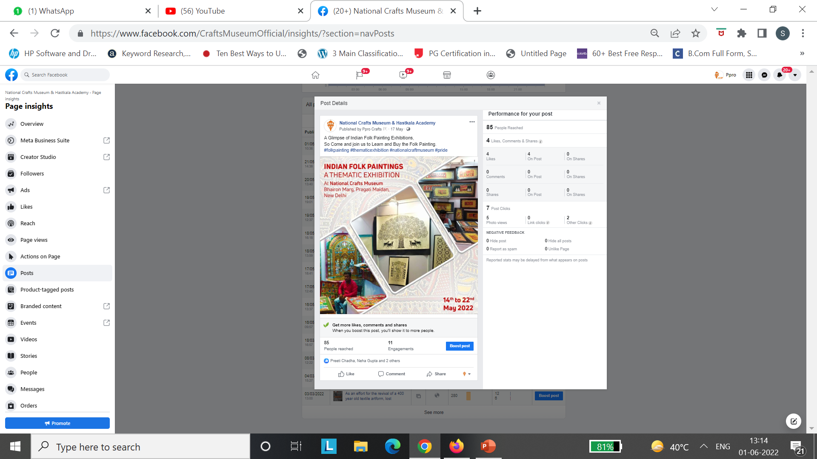
D
I
G
I
T
A
L
M
E
D
I
A
S
O
C
I
A
L
M
E
D
I
A

Slide 21

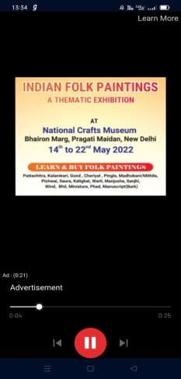
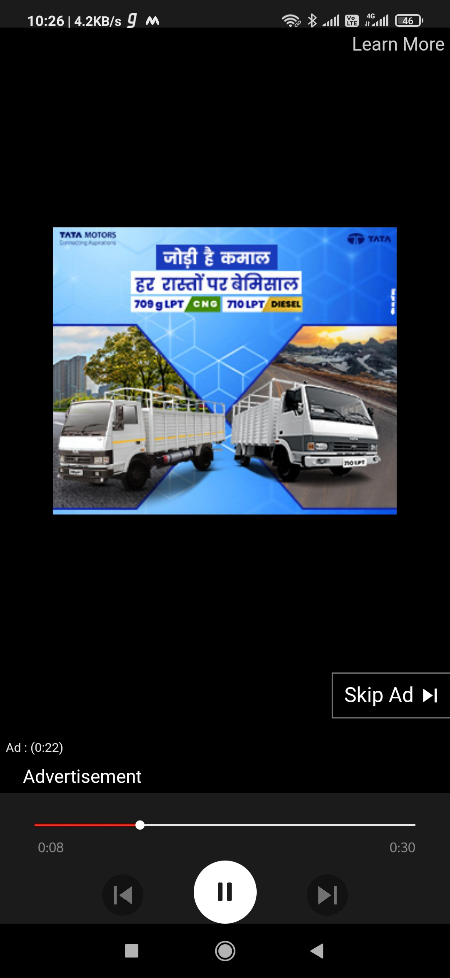
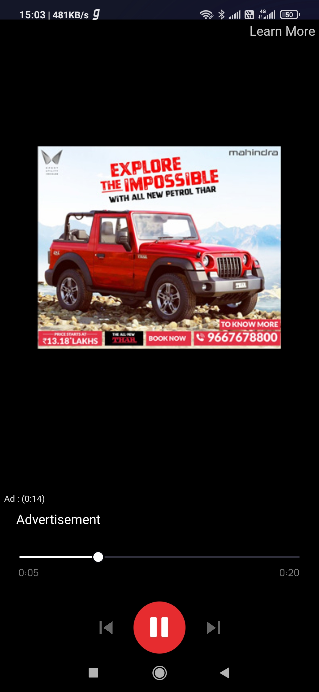
D
I
G
I
T
A
L
M
E
D
I
A
O
O
T
C
A
M
P
A
I
G
N

Slide 22
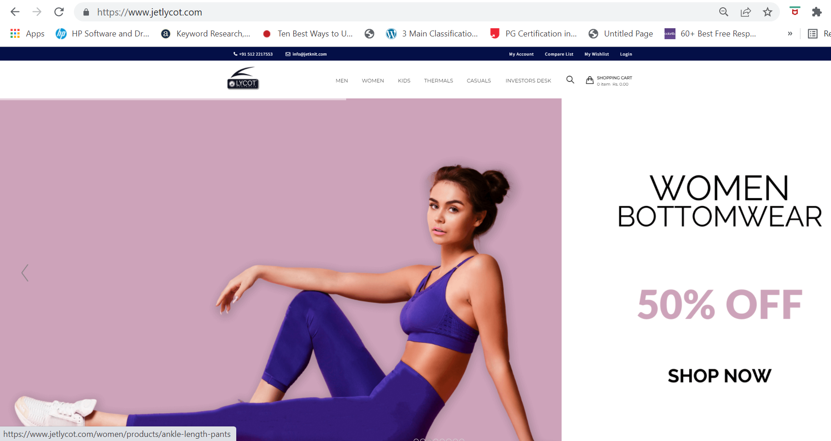
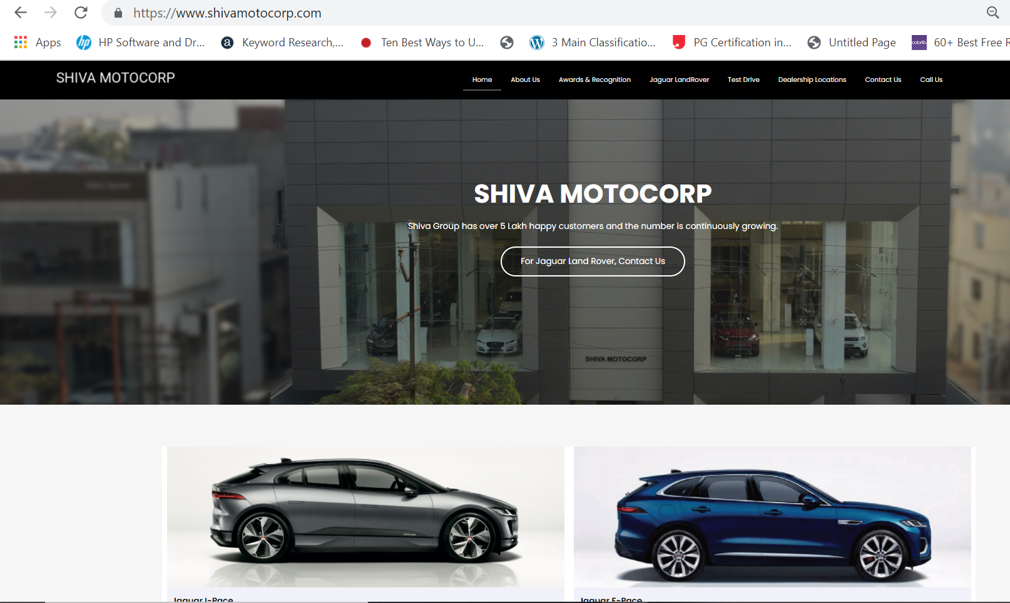
D
I
G
I
T
A
L
M
E
D
I
A
W
E
B
S
I
T
E
M
A
N
A
G
E
https://www.jetlycot.com/
https://www.shivamotocorp.com/

Slide 23
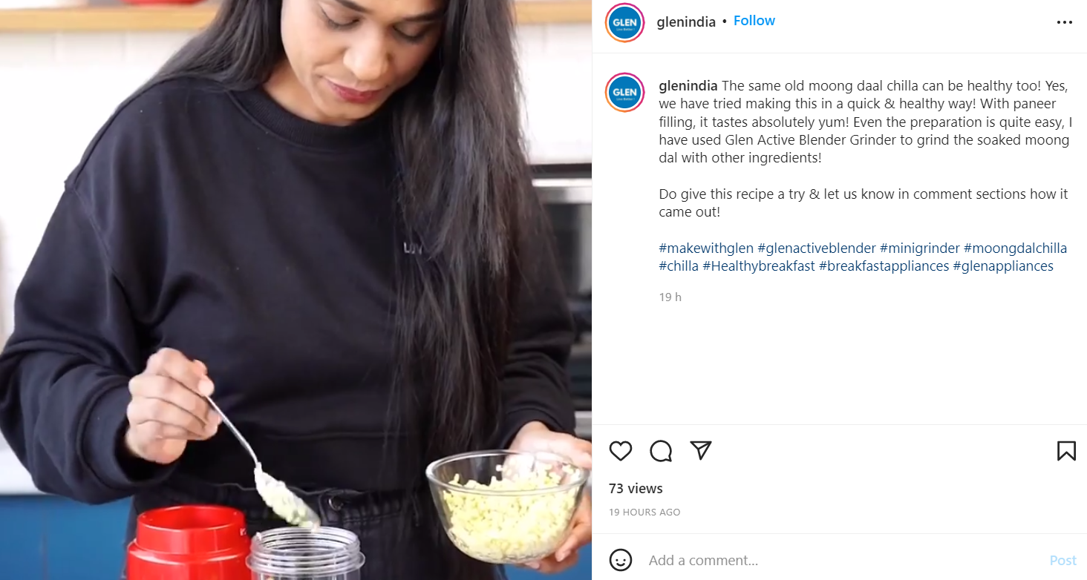
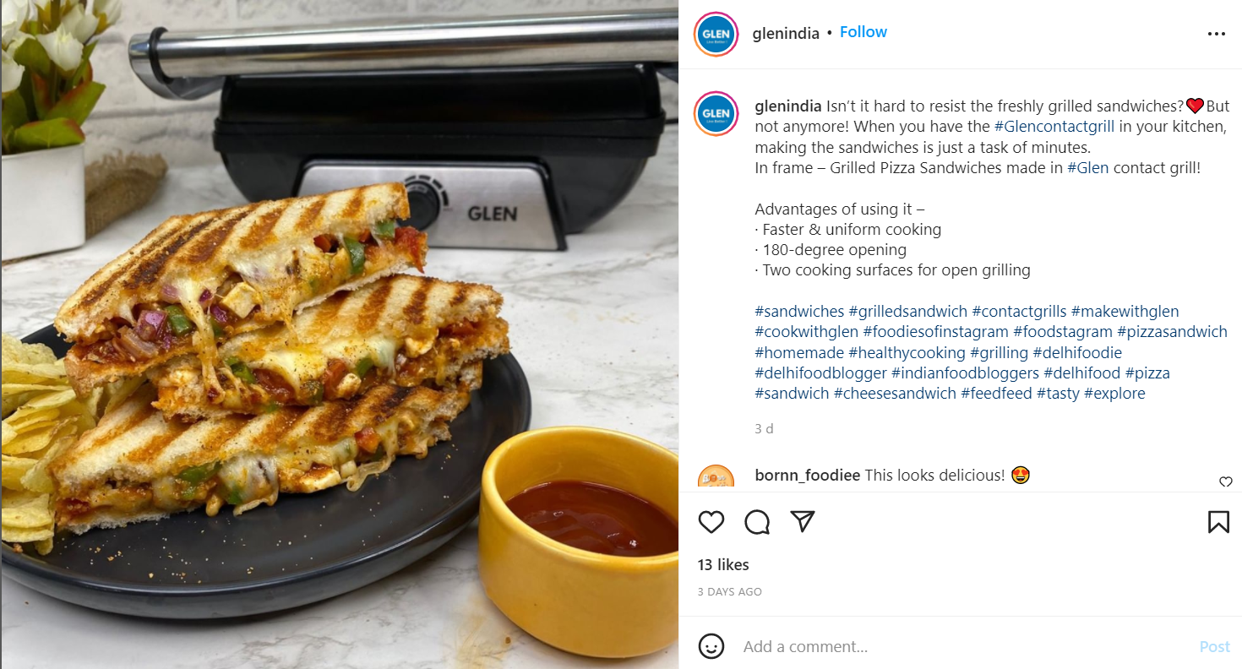
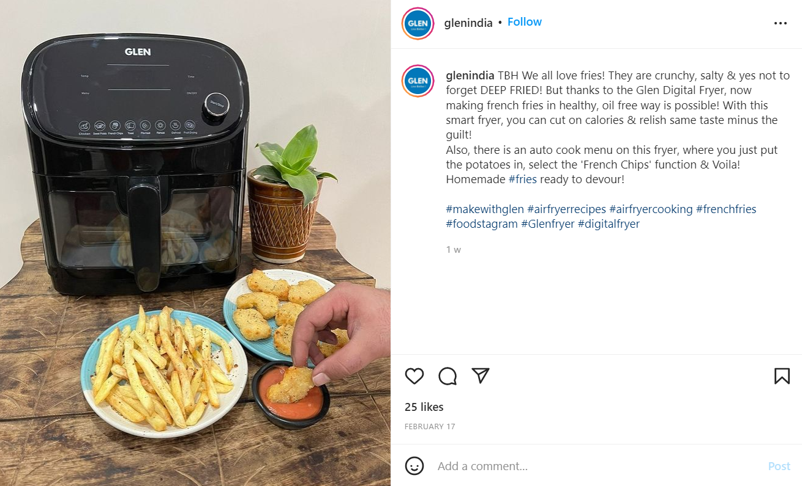
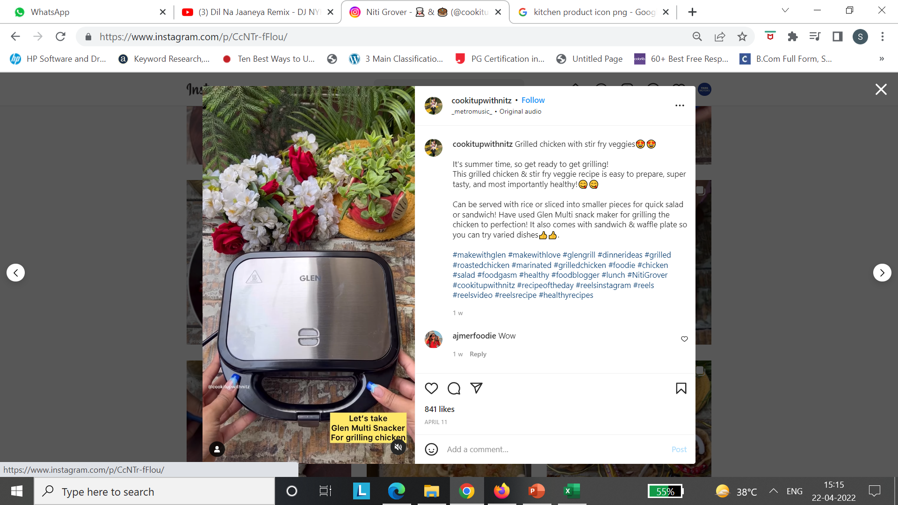
Influencer campaign done for the Brand GLEN APPLIANCES
D
I
G
I
T
A
L
M
E
D
I
A
I
N
F
L
U
E
N
C
E
R
S
Nikita Varma
Gurleen Bedi
Ritika Anand
Niti Grover

Slide 24
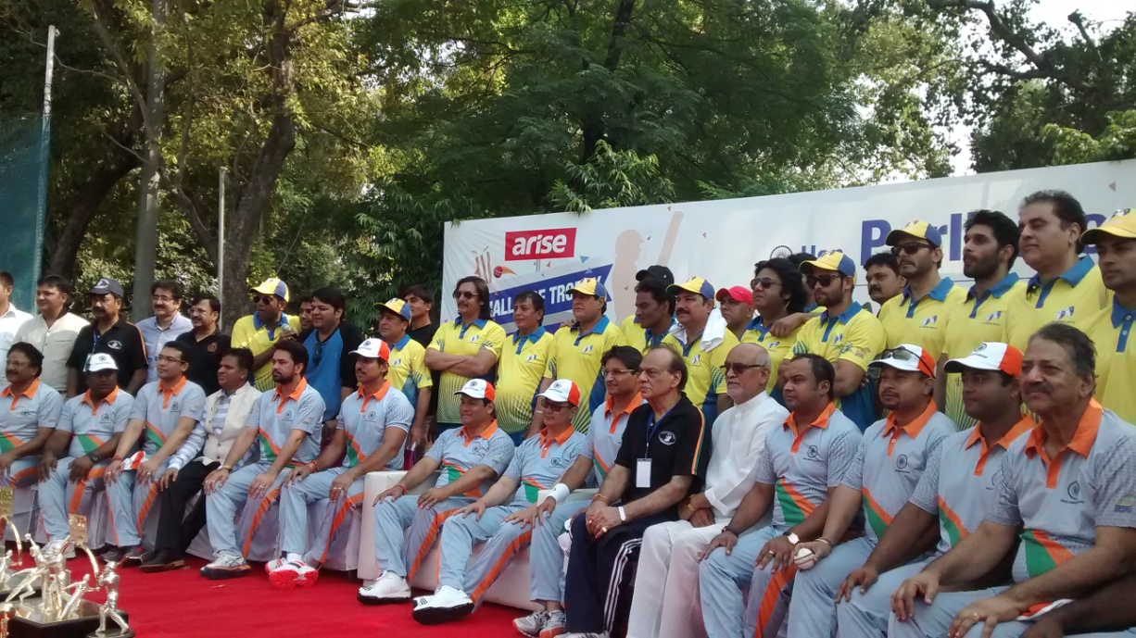
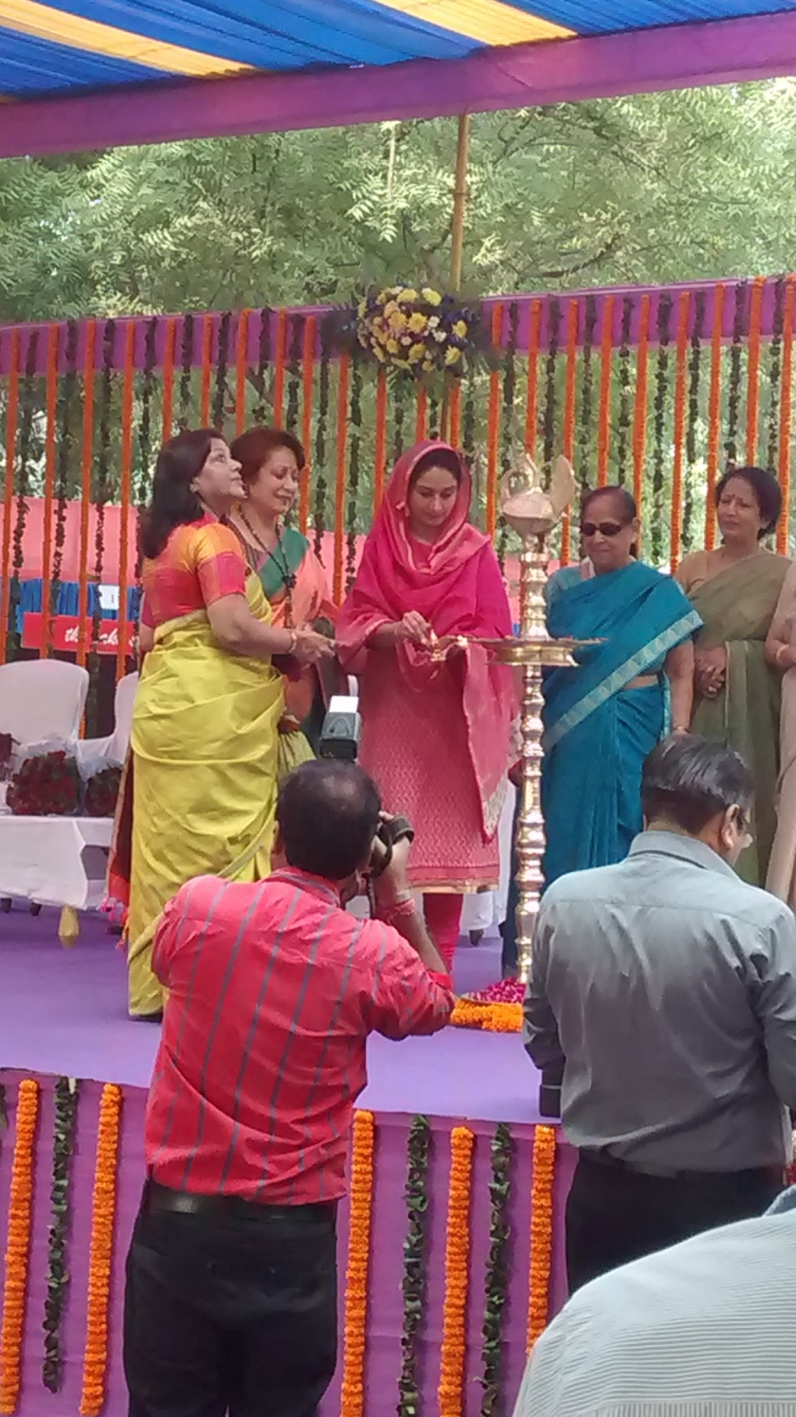
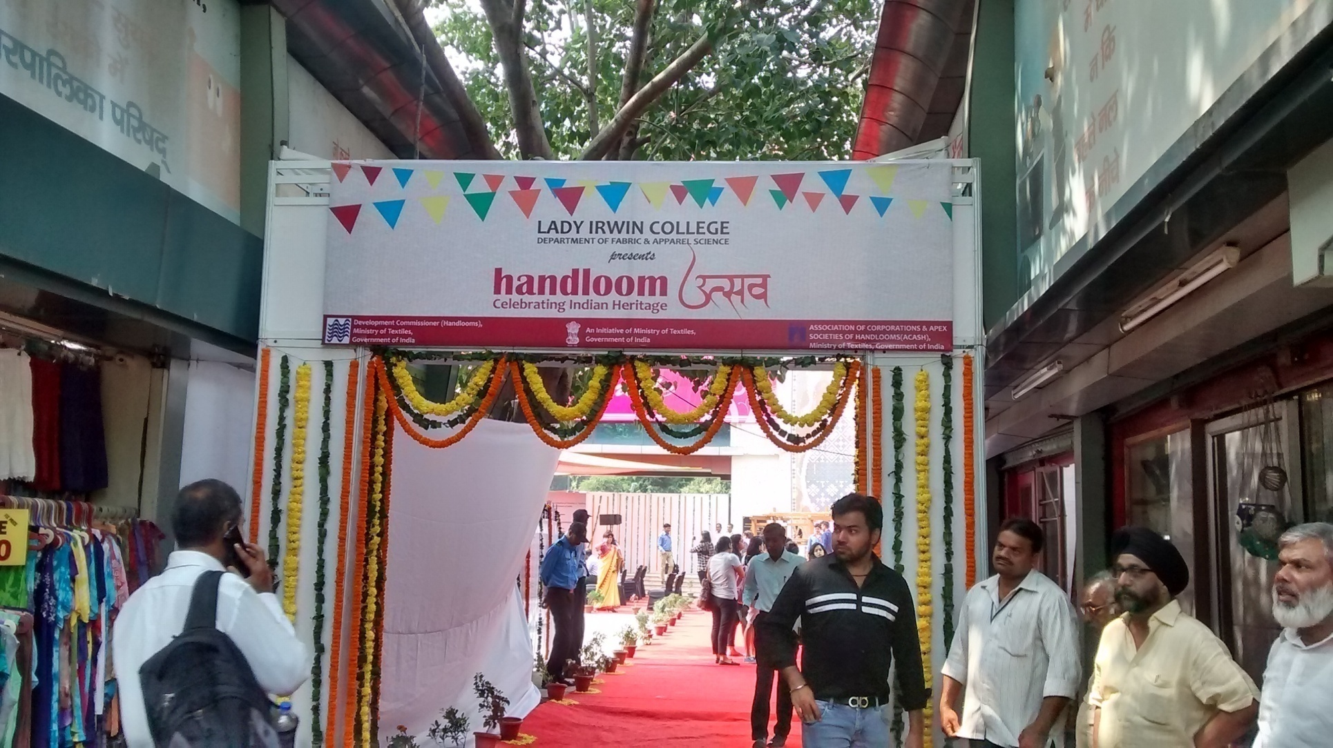
E
V
E
N
T
S
Cricket Match Organised at National Stadium on 25th September 2015 between
Parliamentarian XI and B’town Boys
Handloom Utsav Organised at Handloom Haat , Janpath
on 17th October 2015 in association with Lady Irwin College and Ministry Of Textiles, Inaugurated by Development
Commissioner Handloom Sh Alok Kumar, IAS

Slide 25
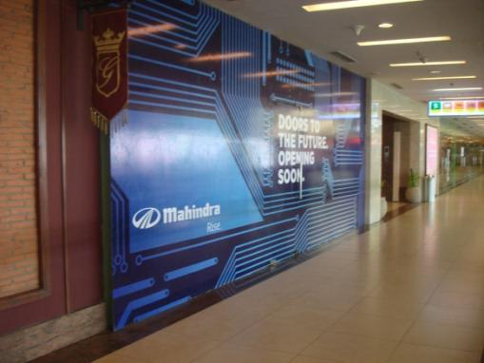
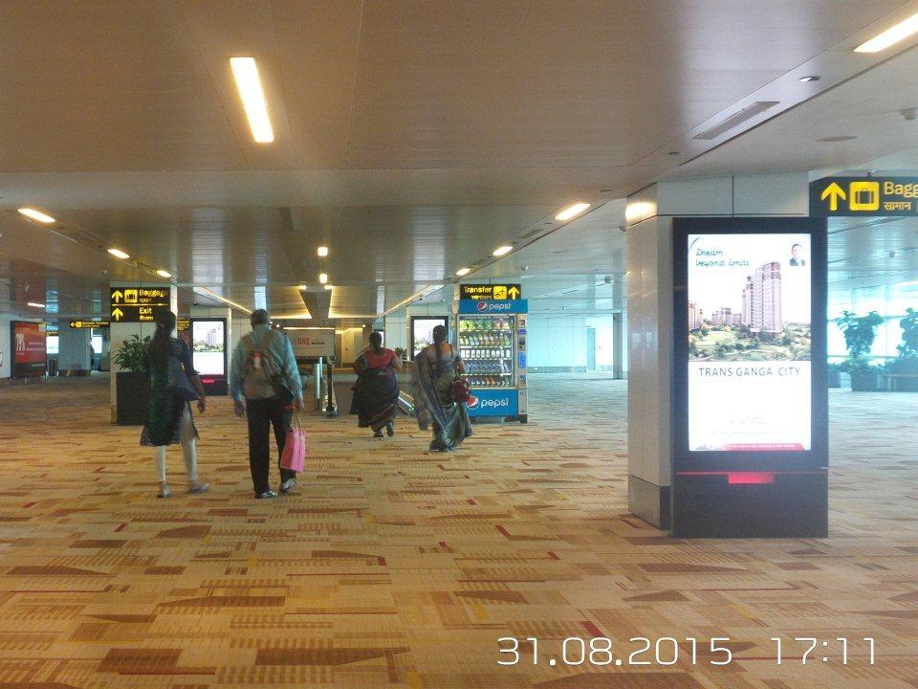
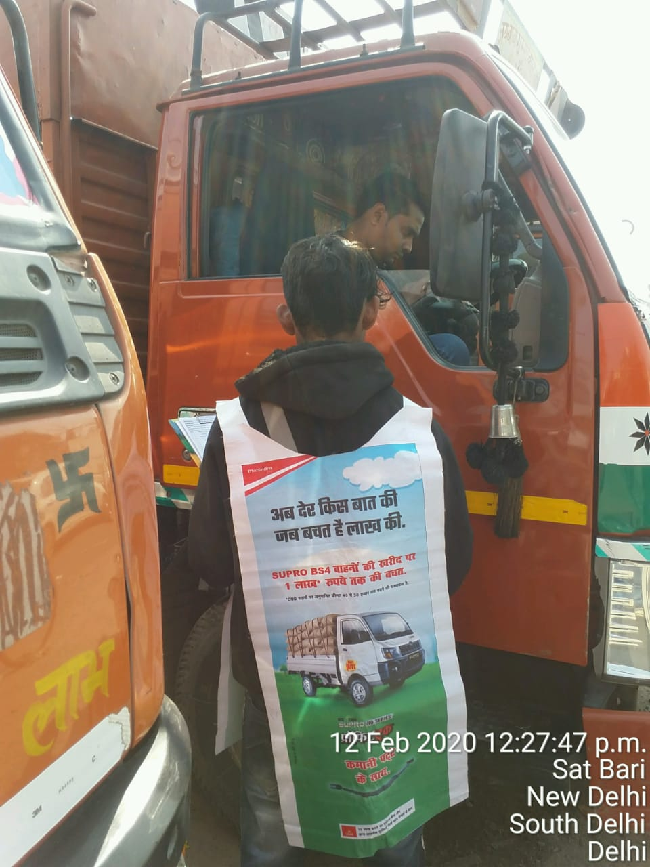
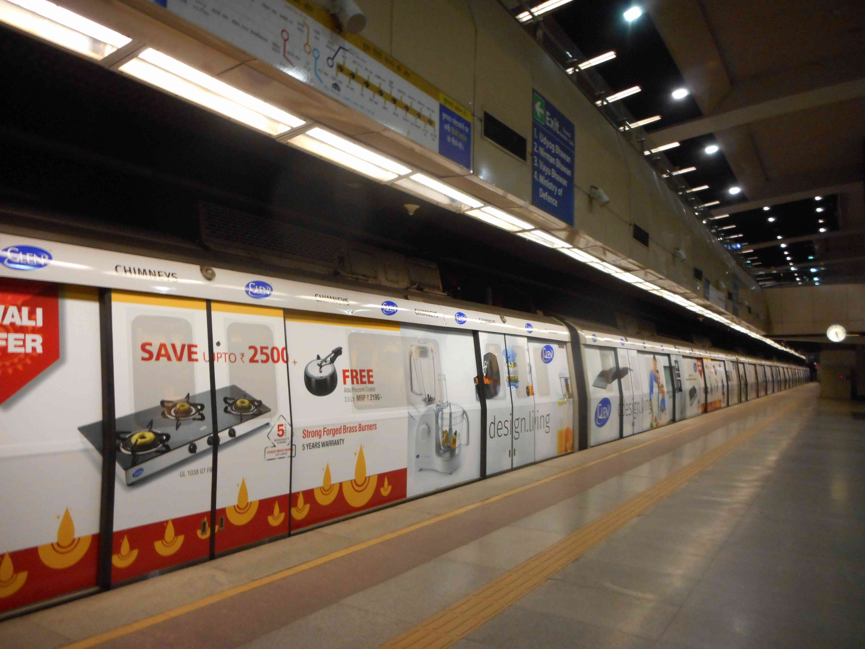
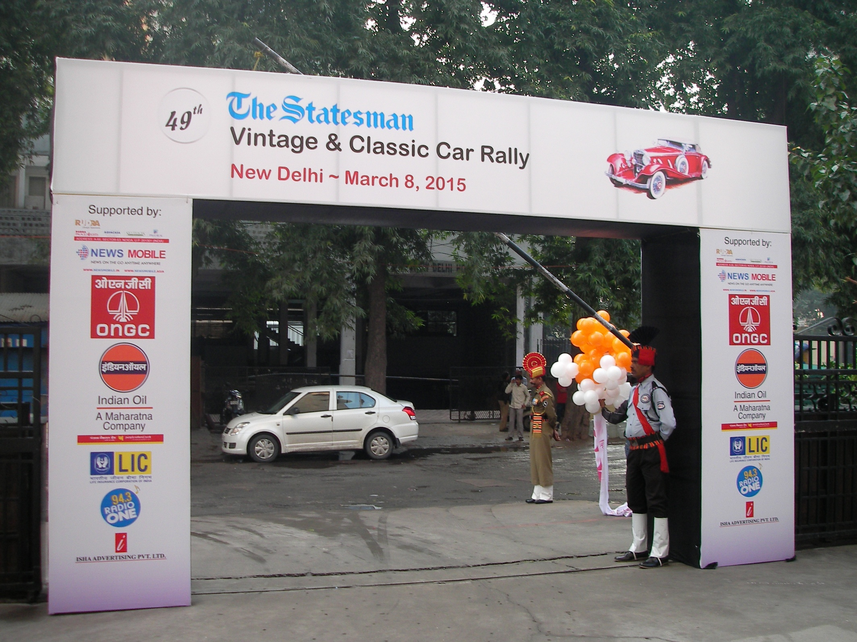
UPSIDC Digital Screen at the Arrival of T-3
terminal of IGI Airport
O
U
T
D
O
O
R

Slide 26
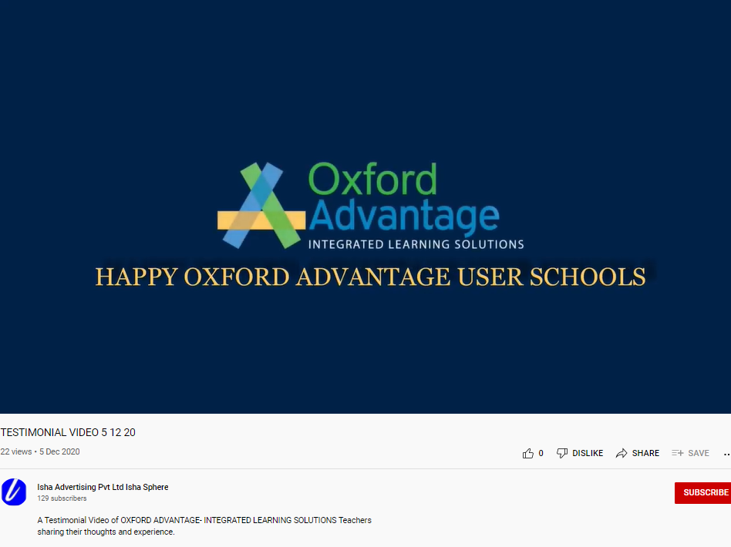
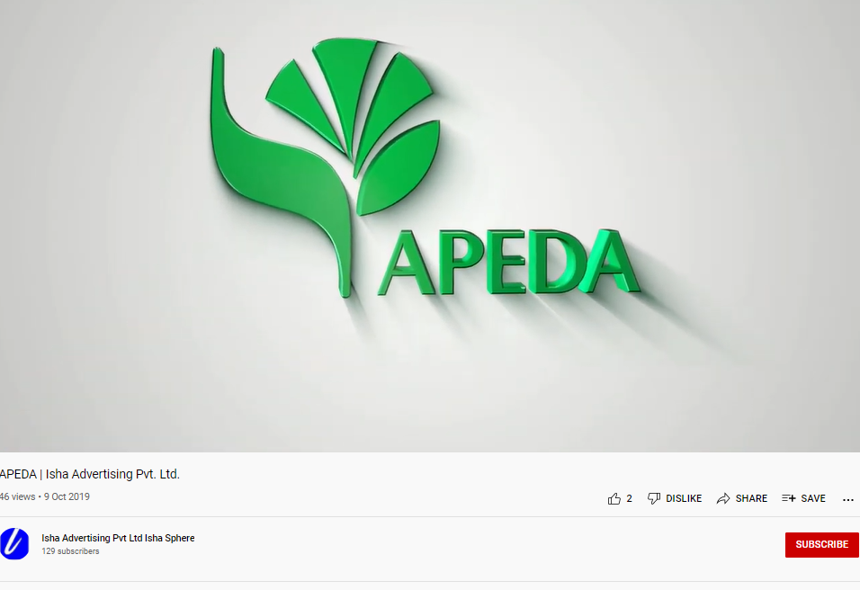
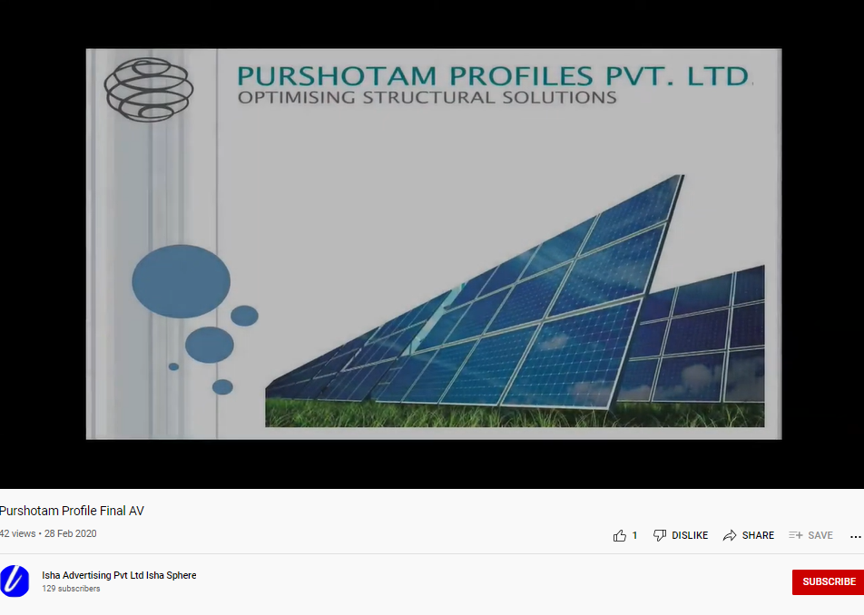
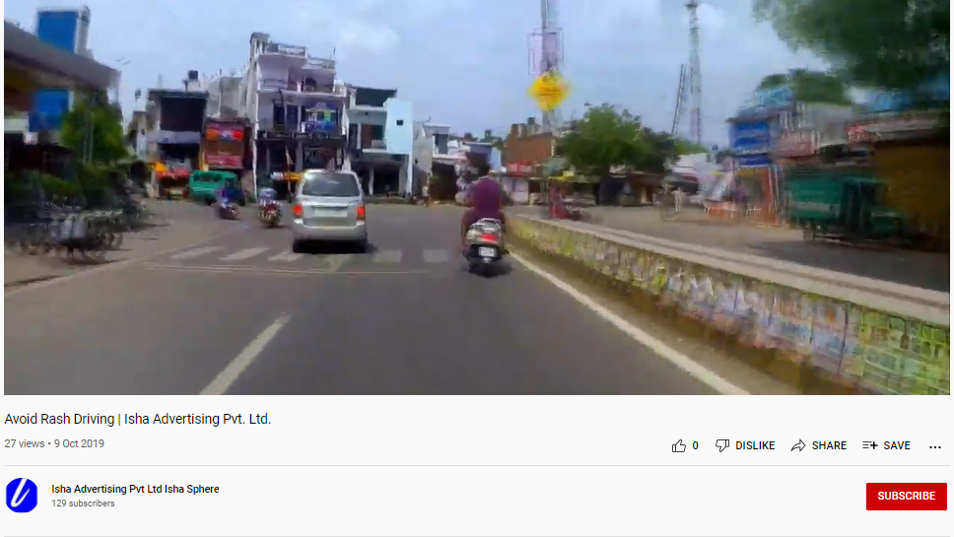
V
I
D
E
O
P
R
O
D
U
C
T
I
O
N
https://bit.ly/3QXJ3Um

Slide 27
THANK YOU!
27

